Slide 1
Research with the greatest potential to transform life for people with Parkinson’s
Professor David T Dexter
Associate Director Research
08/10/2022

Slide 2
Where can you play a role in helping find a cure for Parkinson’s?
Parkinson’s UK involves people affected by Parkinson’s in every step of the journey to finding a cure!
From: Helping the charity determine its research strategy, assessing what research we fund, volunteering to help develop research programmes, taking part in clinical studies to donating your brain!
Everyone can play a role in helping find a cure, even those without Parkinson’s!

Slide 3
Taking part in clinical studies

Slide 4
What are clinical trials and why do we need them
Safety - Any new drug or device needs to be shown that it is safe to use long term in man.
Before a drug or device is approved for human use it has undergone extensive safety testing in animals.
Effectiveness - Does the drug or device deliver significant benefits to people with Parkinson’s.
Slowing Parkinson’s progression - Does the drug or device significantly slow the progression of Parkinson’s compared to those in the placebo or dummy drug group.
Parkinson’s progresses slowly so these trials are run over many months - years!
Managing Parkinson’s symptoms - Does the drug or device significantly improve symptom management
Movement symptoms - tremor, stiffness, slowness of movement
Other symptoms - anxiety, depression, sleep, constipation, memory
These trials are much quicker - run over several months

Slide 5
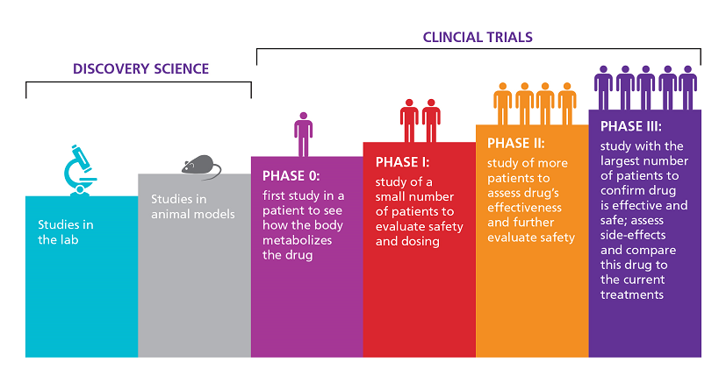
Phases of drug development
Need to recruit hundreds of participants before a drug is approved

Slide 6
Which volunteers are they looking for?
Newly diagnosed but untreated people with Parkinson’s
Recently diagnosed people with Parkinson who are on a stable medication plan.
People with Parkinson’s who are more advanced in their condition and are experiencing problems with medication - fluctuations in response, dyskinesias or abnormal movements, hallucinations etc.
Non-motor symptoms - Depression, anxiety, sleep problems, memory problems, constipation etc.
Something for everyone at every stage of Parkinson’s
Full information and support is provided

Slide 7
Benefits of taking part in clinical studies
Safety - Your safety is the primary concern of the clinical studies team. You can withdraw at any time.
Taking charge - playing a vital role in the development of new treatments that will benefit people with Parkinson’s globally
Access to clinical experts - regular assessments by top neurologists and Parkinson’s nurses
Care and support - Available 24 hours a days throughout the trials and during any follow-up period
Feedback - Personal feedback on the results of the trial

Slide 8
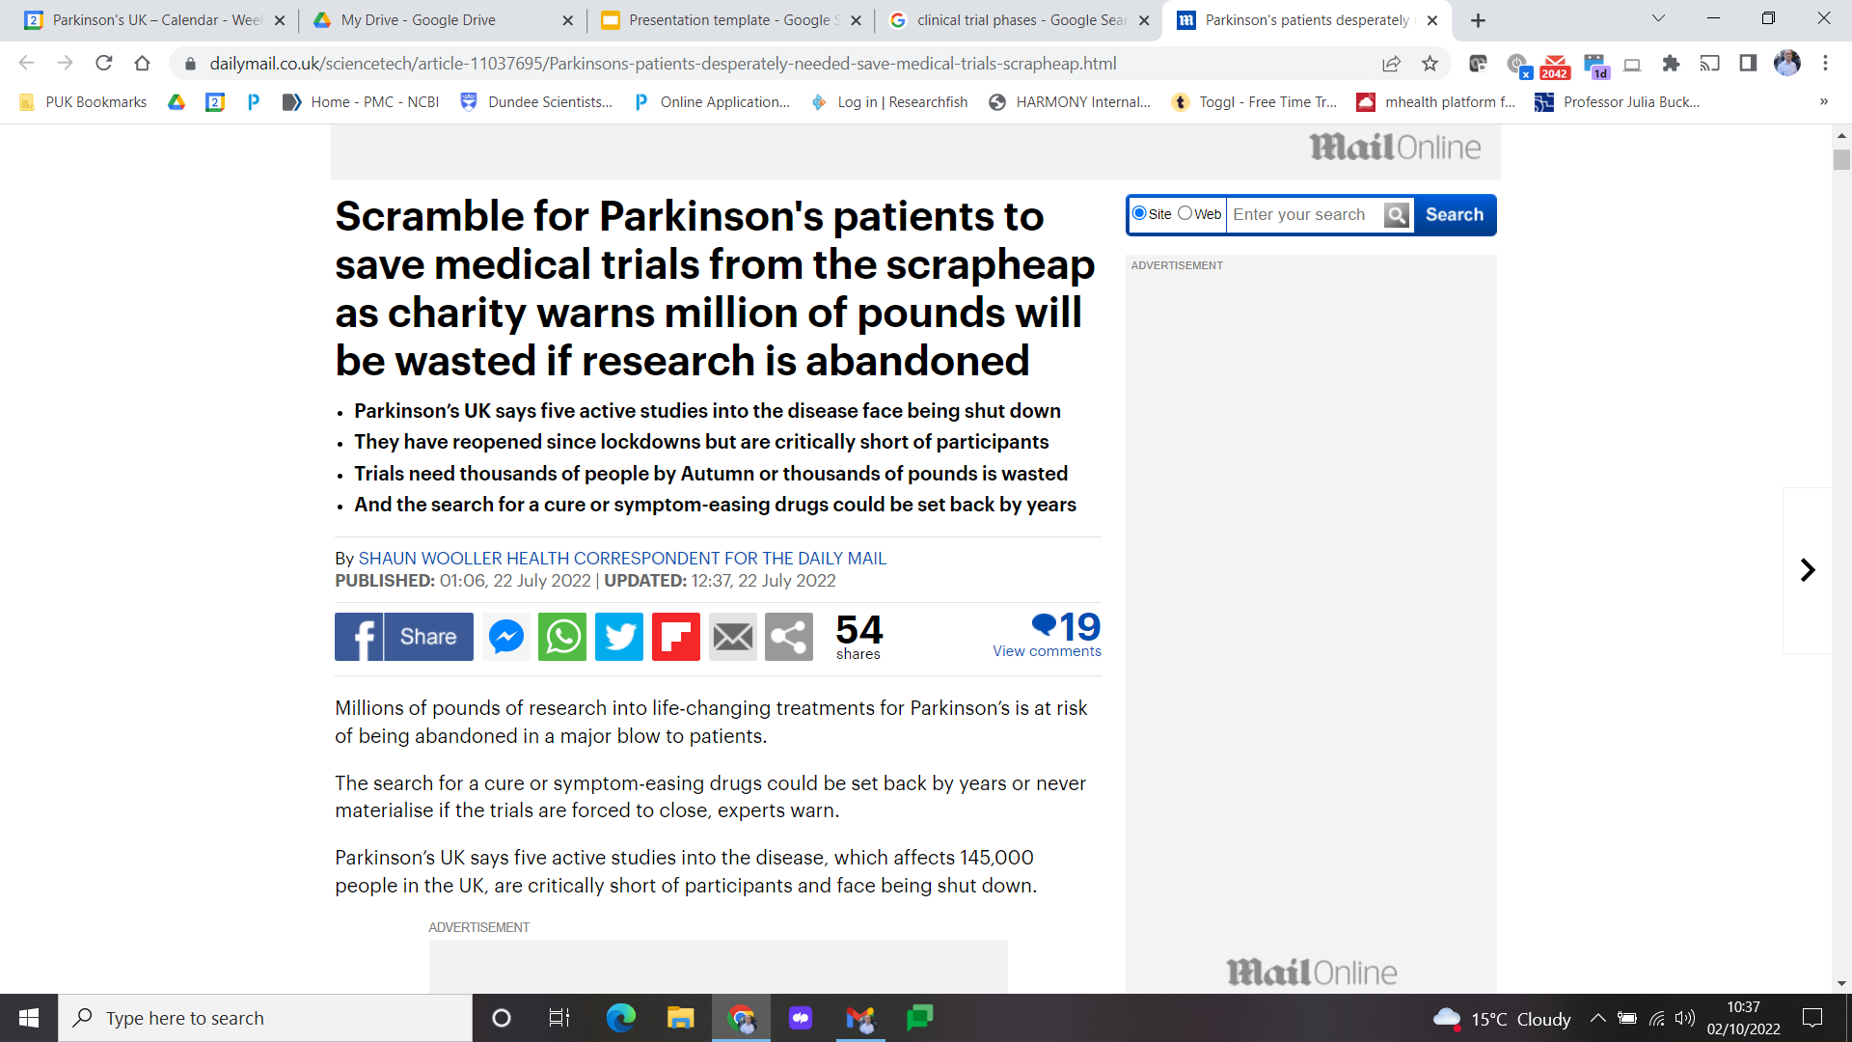
Are we recruiting enough people?
There is an urgent need for more volunteers otherwise we will never cure Parkinson’s

Slide 9
Clinical studies featured in the Daily Mail
CHIEF-PD - Balance and falls (Previously been funded by Parkinson’s UK). Phase 3 clinical trial of a sticky medication patch for falls in Parkinson's. Still looking for participants
Daily living and drooling (Parkinson’s UK funded). Wrist-worn device to manage drooling and assisting daily life of people with Parkinson's. Now fully recruited
TOP HAT - Hallucinations (Parkinson’s UK funded) . Repurposing an existing drug to see if it can help with Parkinson's hallucinations. Still looking for participants
AND-PD - Anxiety. Understand anxiety in Parkinson’s. Still looking for participants
ADEPT-PD - Low mood. A potential treatment for low mood in Parkinson’s and to see if it can slow the progression of the condition. Still looking for participants
There are still many other clinical studies looking for volunteers!!!

Slide 10
Not all studies involve taking drugs

Slide 11
Non-drug approaches and surveys
Non-drug approaches, such as devices and apps, can potentially deliver benefits to people with Parkinson’s in the short-term whereas drug development can take years.
Parkinson’s UK is investing more funding in this area
Extensive number of research opportunities for testing devices and Apps.
Many research projects are running surveys - personal experiences of people with Parkinson’s, what symptoms people experience, surveys which help shape research projects - mainly on-line.

Slide 12
What types of research do we fund?

Slide 13
Research funded by Parkinson’s UK
Funded over £105m worth of research
All funding decisions are done in consultation with people affected by Parkinson’s.
Basic science projects which increase our understanding of what causes Parkinson’s
Early stage laboratory based drug discovery
Clinical research - development of new clinical methodology and clinical trials
Non-drug approaches - devices, apps and platforms
Service improvement awards - via the Excellence Network
Parkinson’s Virtual BioTech - large scale investment to accelerate drug development at all stage from laboratory based projects to clinical trials.
Longitudinal cohorts & Parkinson’s UK Brain Bank
Strategic Partnerships - Critical Path for Parkinson’s

Slide 14
Where can I find out about what research opportunities are available?

Slide 15
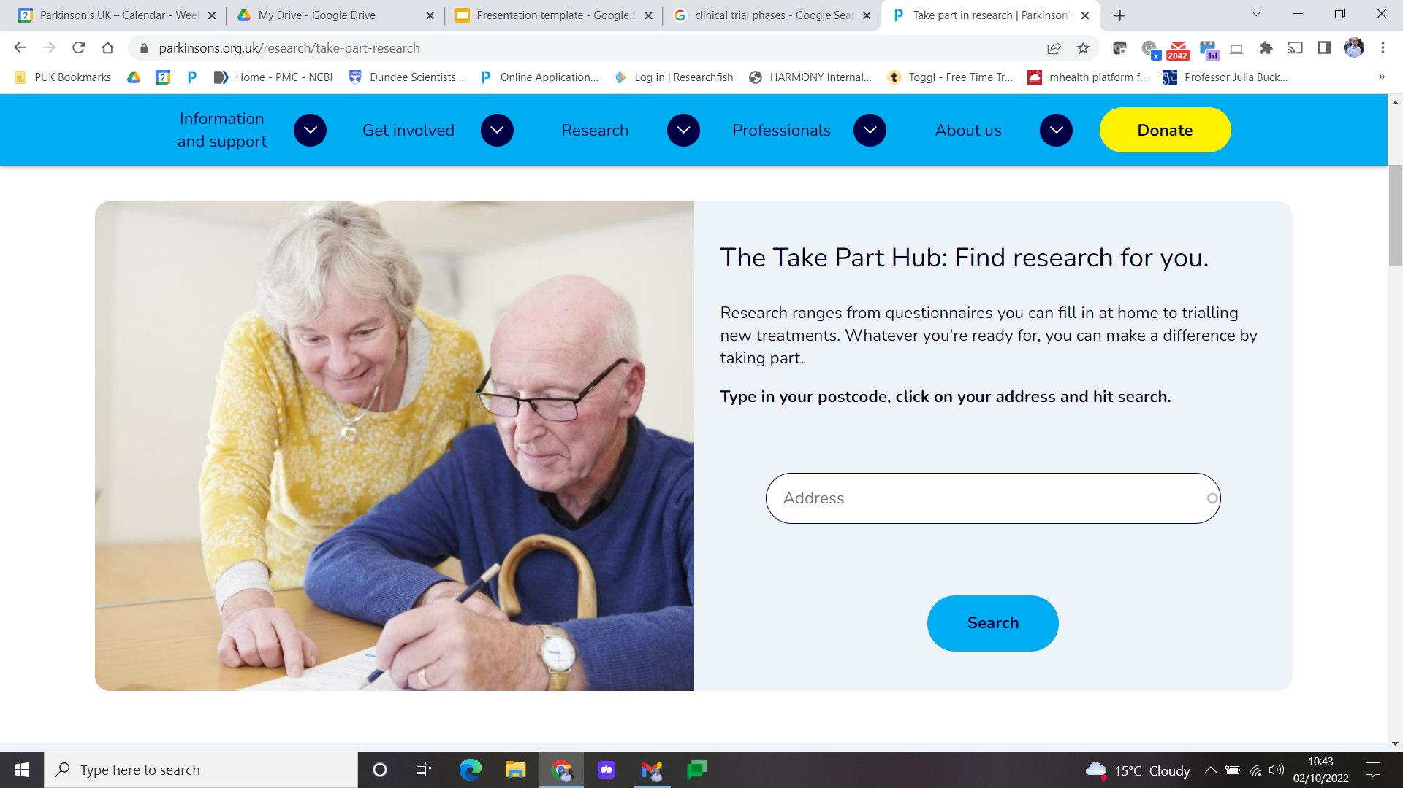
Take Part Hub - Postcode search for Research

Slide 16
Research support network (RSN)
Growing network of more than 7,000 people affected by Parkinson’s who have a specific interest in Research!
Have your say on what research is needed and how it is carried out.
Stay up-to-date via regular communications
Find out about the latest clinical trials looking for participants, both drug and device studies.
Have your say by taking part in surveys
Get connected to what is going on in research and the scientists doing the research
Find out about research meetings/conferences

Slide 17
Volunteering to help shape research

Slide 18
Research Volunteering
Appropriate training is given for all roles
Involves people with Parkinson’s and people affected by Parkinson’s.
Wide variety of roles:-
Board of Trustees & Research Strategy Board.
Lay grant and Virtual BioTech project reviewer.
Patient and Public Involvement (PPI) - working alongside researchers to identify important research questions, helping shape clinical studies, developing new clinical measures.
Research champion

Slide 19
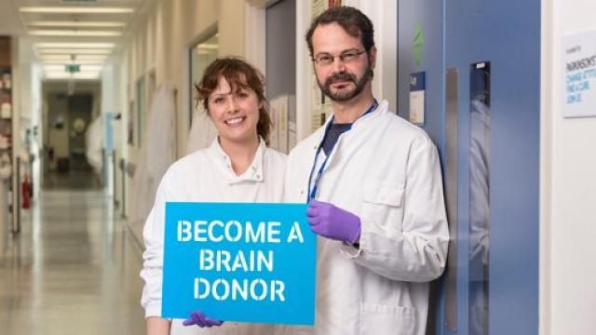
Parkinson’s UK Brain Bank at Imperial College
Donating your brain for Research
https://www.imperial.ac.uk/medicine/multiple-sclerosis-and-parkinsons-tissue-bank/

Slide 20
Contact:
ddexter@parkinsons.org.uk

