Slide 1
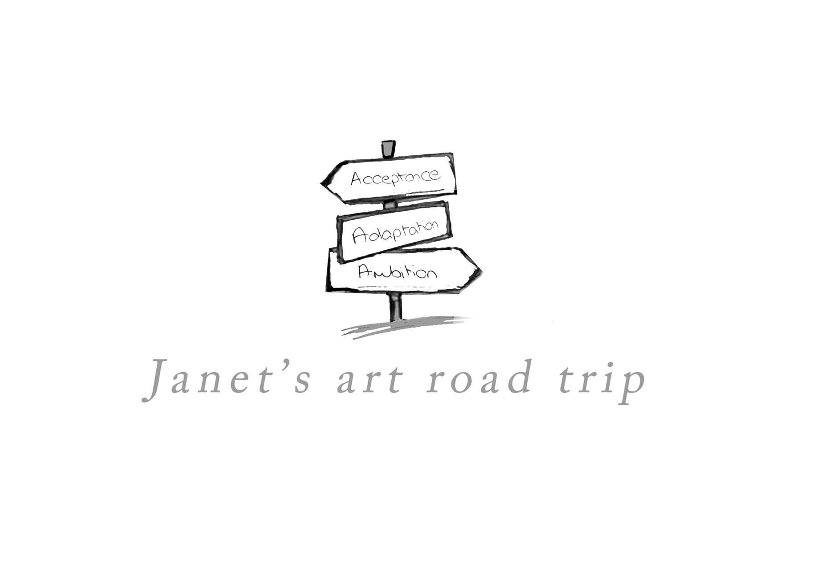
Art, Creativity, and Living Well With PD
Dr Janet Shipton

Slide 2
A Design Director with a PhD in Design / Consumer Science, running my own consultancy business.
At the end of 2017 on holiday in the Caribbean when writing a post-card, I noticed my handwriting had become illegible. This combined with other subtle changes prompted me to go to my GP.
After a few months of appointments and brain scans I was diagnosed with Parkinson’s on Sept 20th2018.
Consultancy work began to dry up due in part to my symptoms, and partly due to a lack of confidence after my diagnosis.
I’ve since been on a mission to raise money for research and awareness of a misunderstood condition.
London to Paris bike ride
24-hour non-stop danceathon
20-day art retreat
12-hour boxing challenge
Formed theatre group “parky Players”, co-wrote and performed at Edinburgh Fringe.
I’ve also got divorced, lost and gained friends and family, and had to reinvent myself.

Slide 3
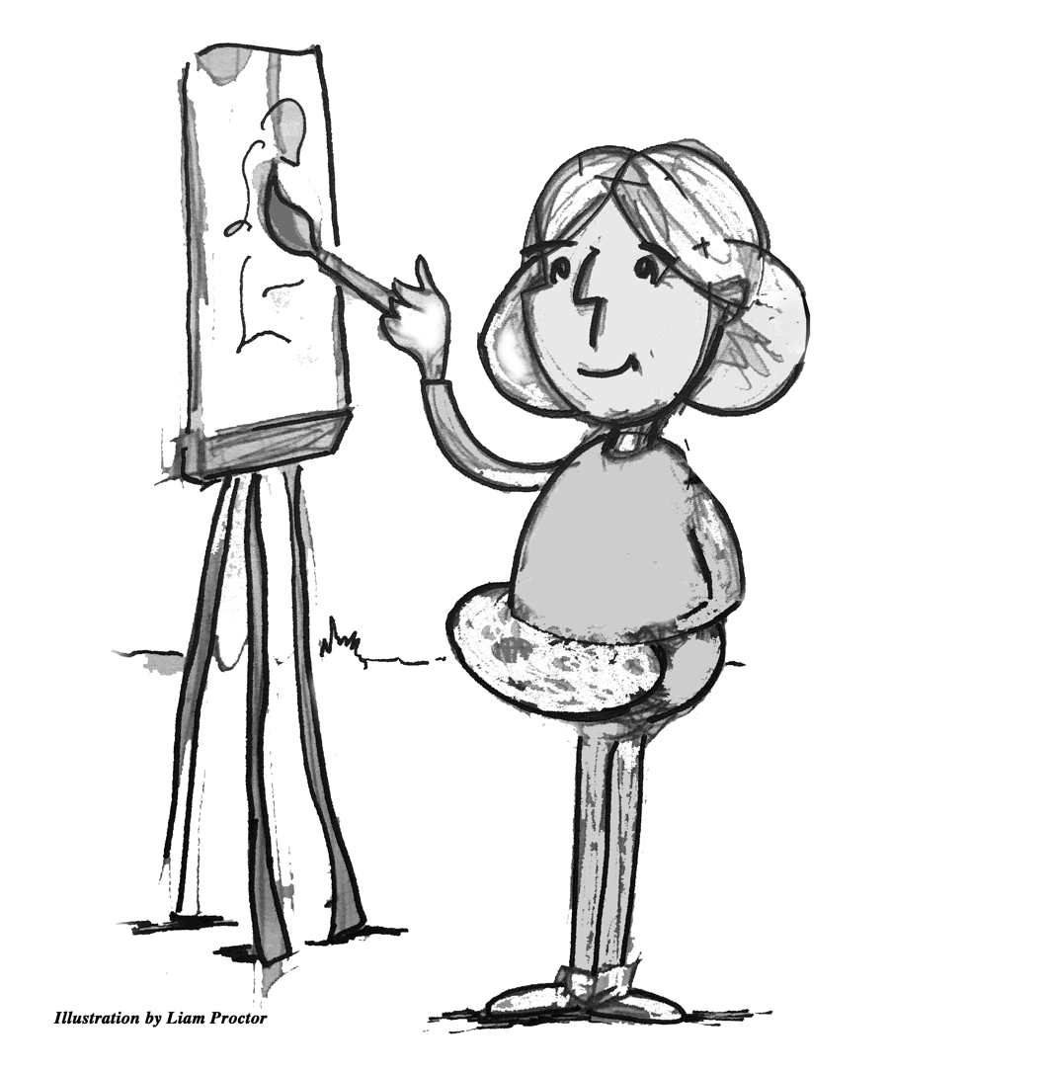
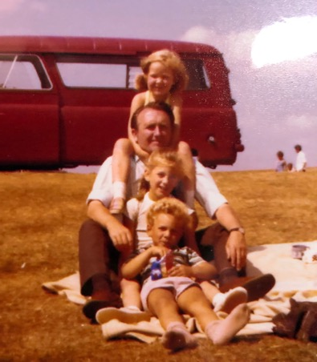
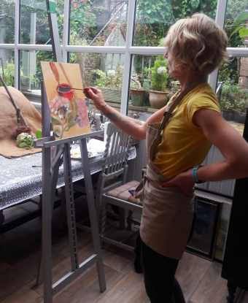
I'd always enjoyed art and it was my 'happy place' when younger.
Painting and art was the thing that gave me confidence and self esteem.
After diagnosis I decided to revisit that passion, and I'm now a professional artist with my own studio / gallery. I also teach art and am passionate about its therapeutic benefits and enjoy sharing this love of creating.
When diagnosed young, you can feel very alone, and different from everyone else around you.
It's important to find a way to accept, adapt and stay positive.

Slide 4
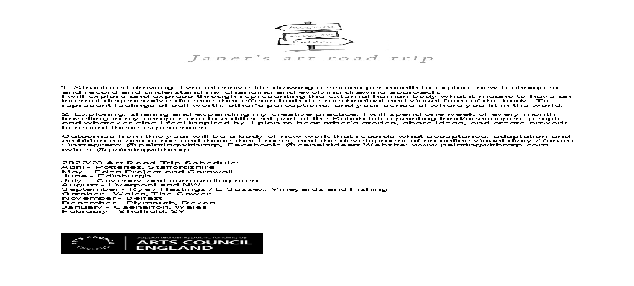

My Arts Council England Application:

Slide 5



Slide 6
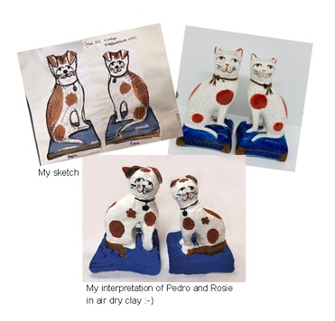
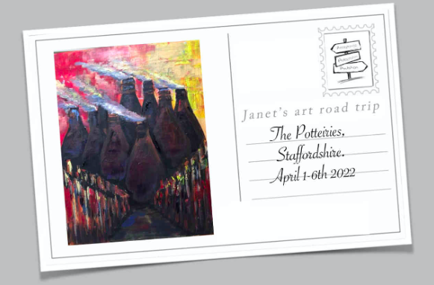
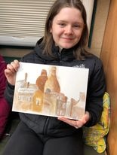
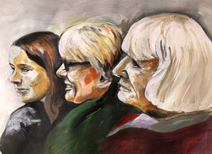
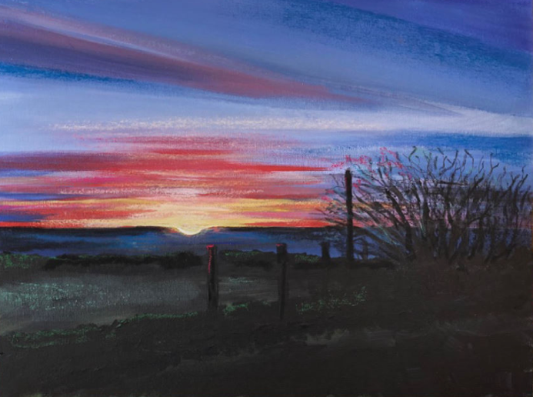
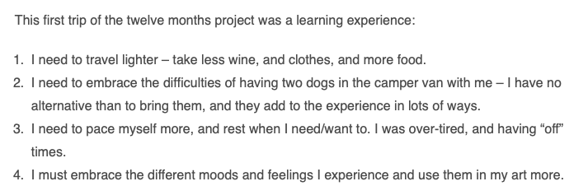

Slide 7
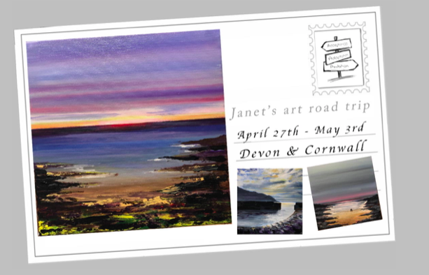
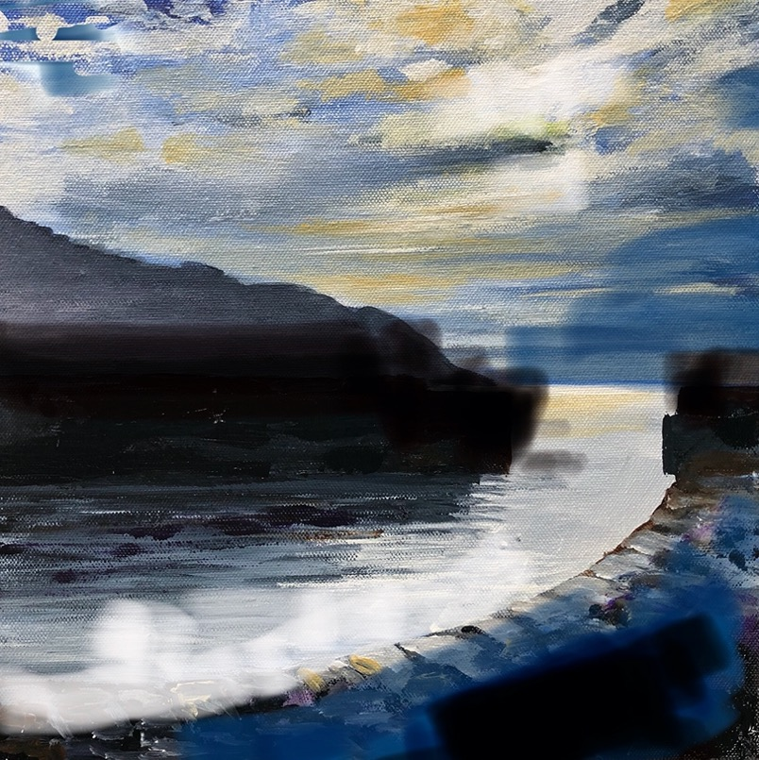
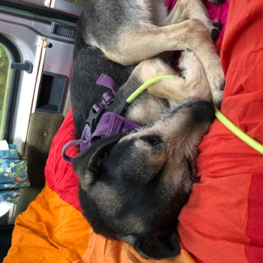
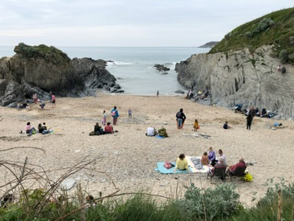
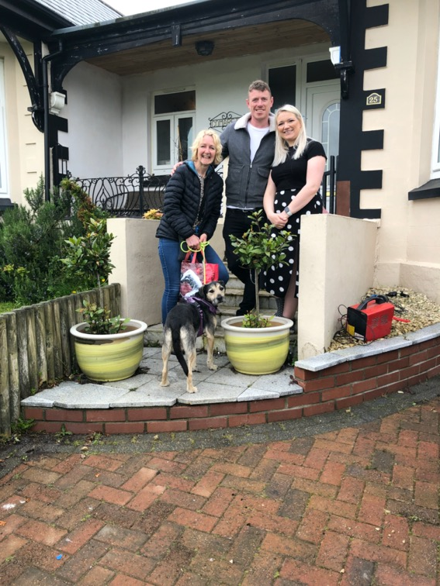
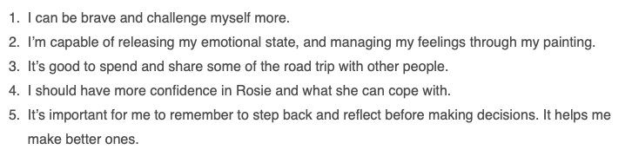

Slide 8
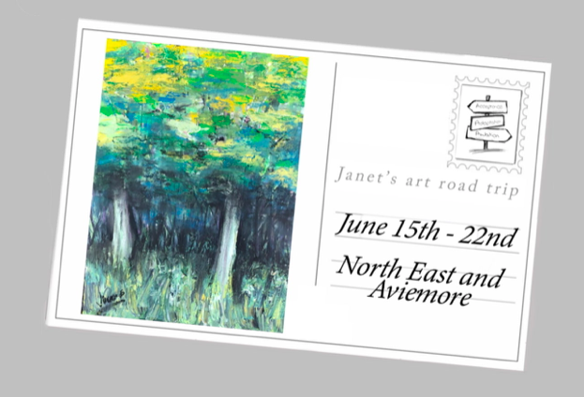
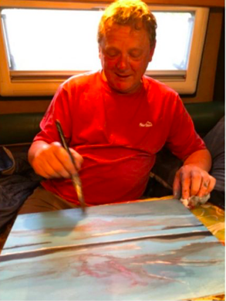
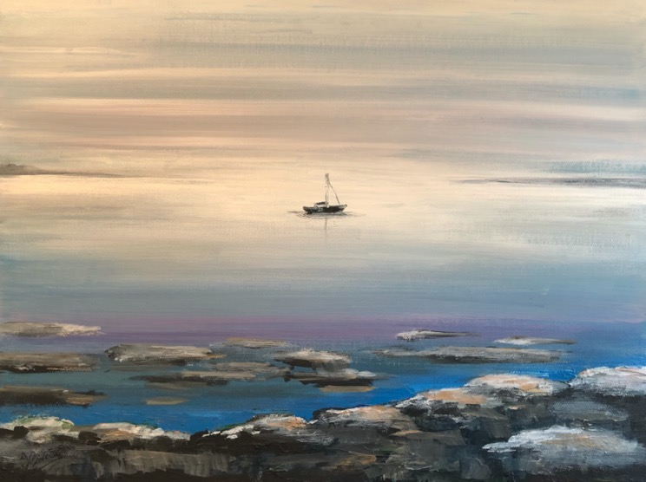
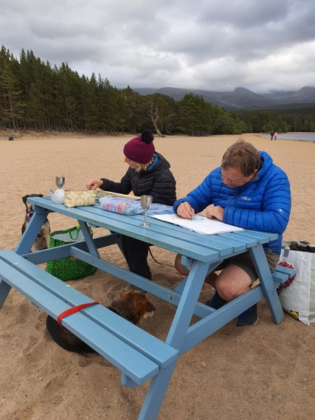
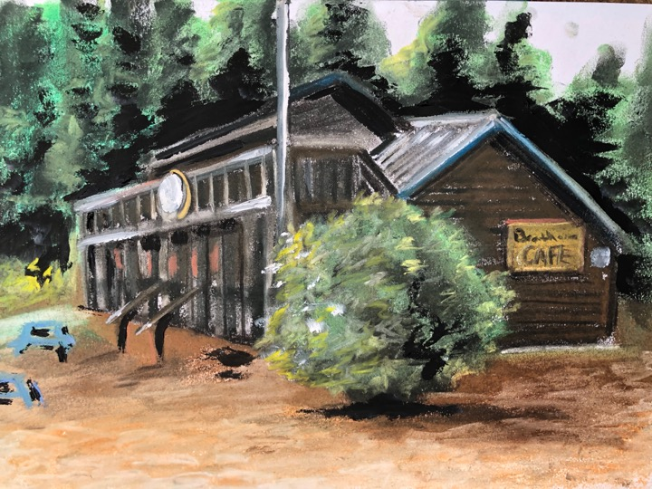
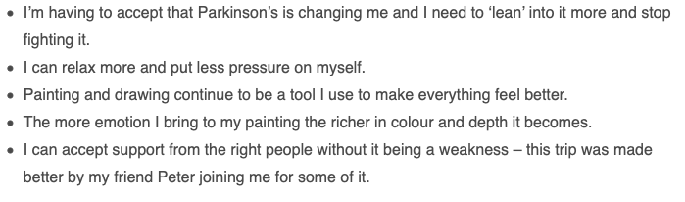

Slide 9
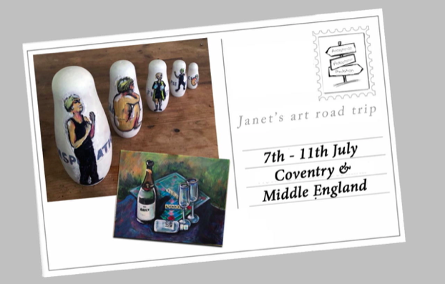
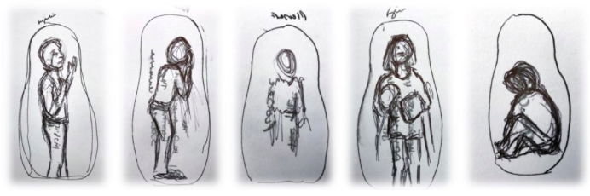
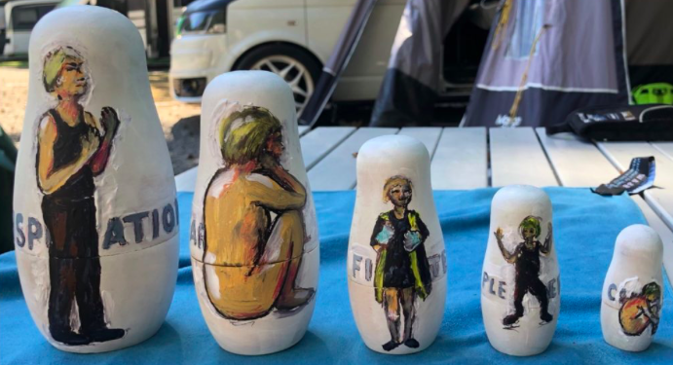
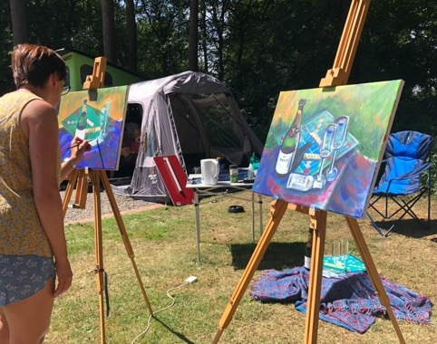
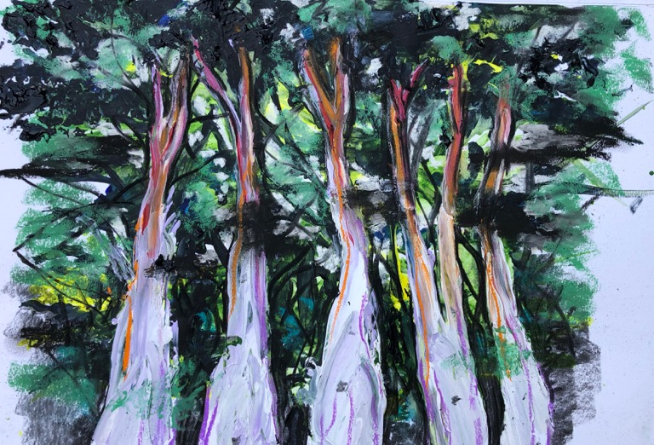
Heat, trees, friends and self reflection.

Slide 10
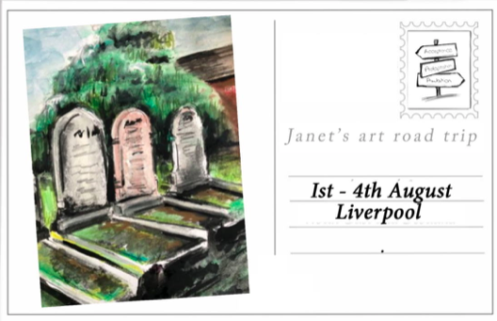

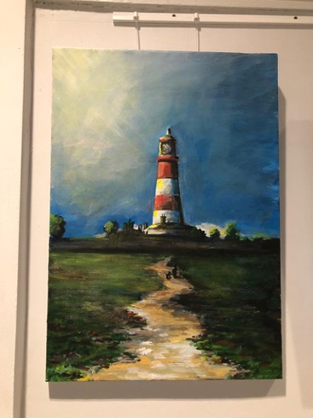
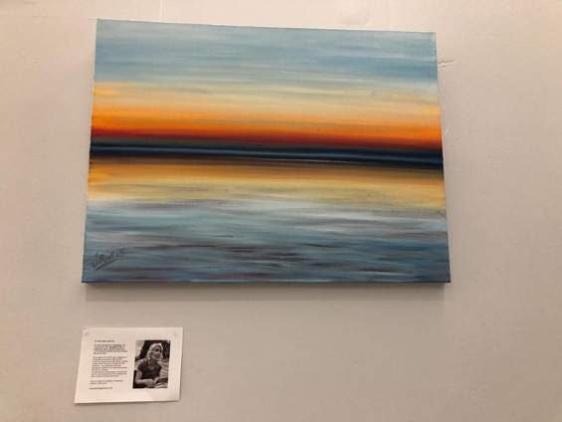
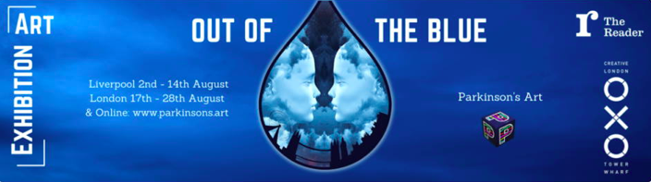

Slide 11
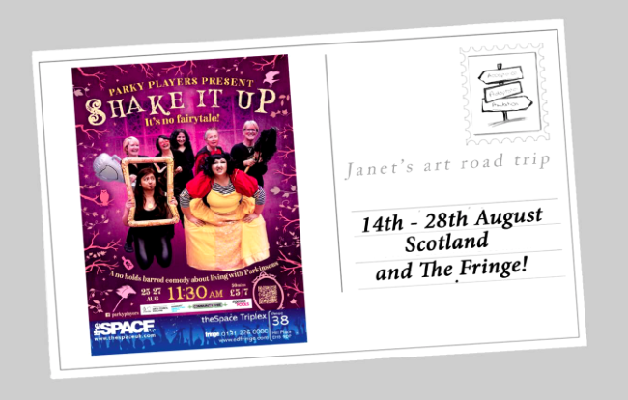
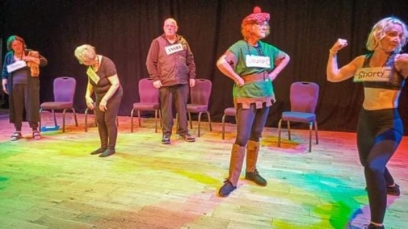
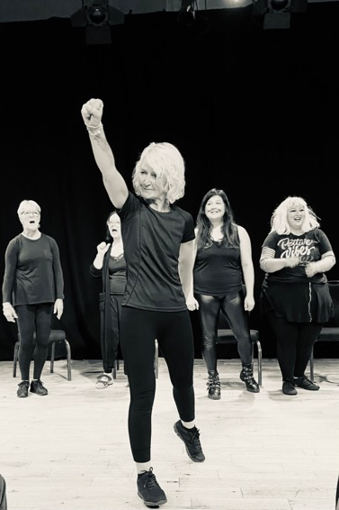
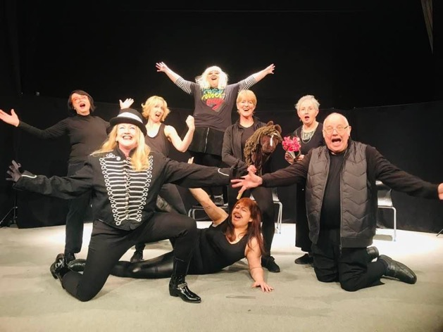
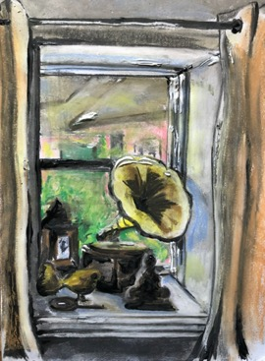
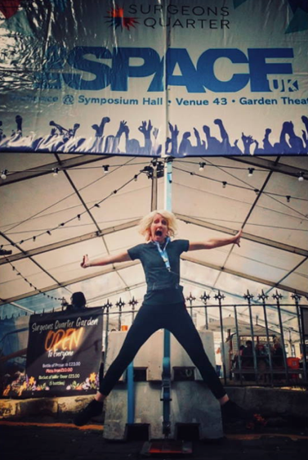
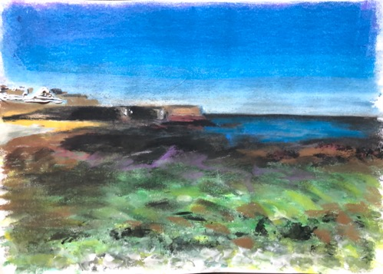

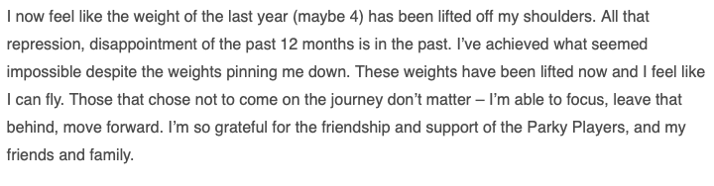

Slide 12
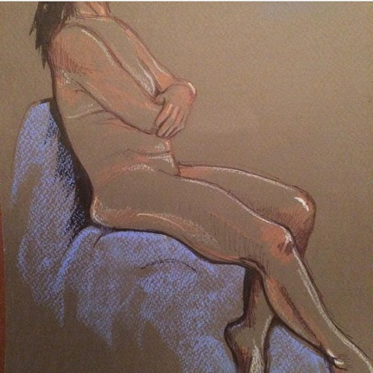
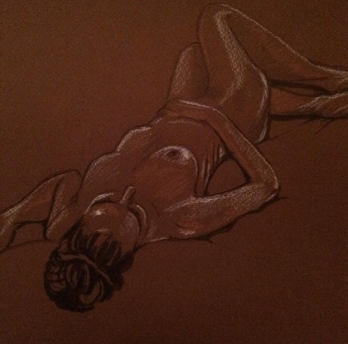
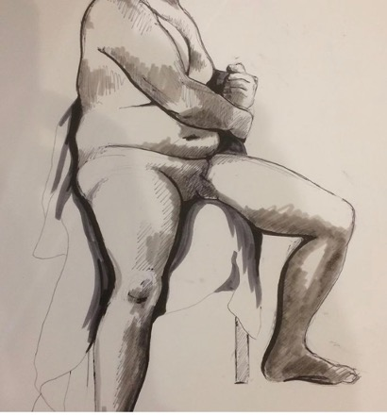
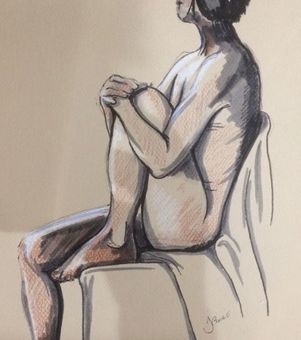
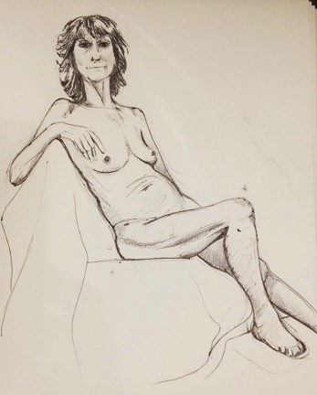
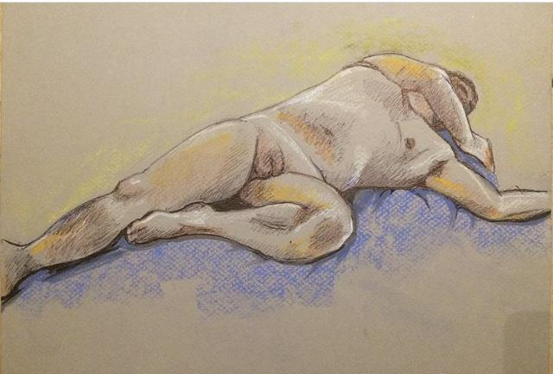
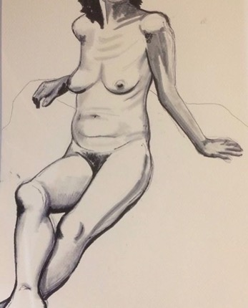
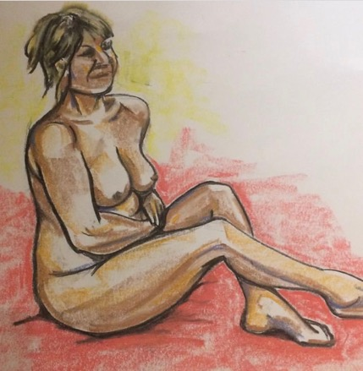
2019/20 Life drawings: fine lines, detail, cross hatching and shading, precise, pencil, light pastels and pen

Slide 13
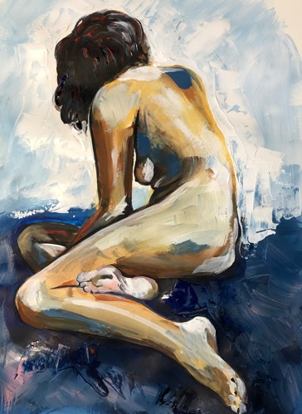
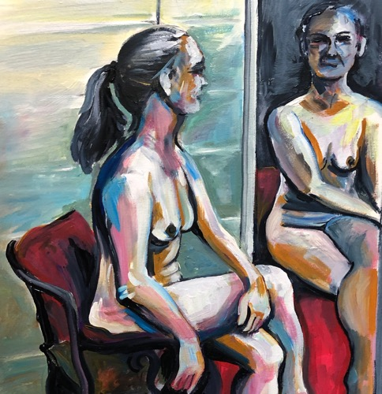






2022 Life drawings: more colour, more freedom, bigger strokes, always acrylic or pastels. Less detail, less fine work, less care

Slide 14

My Parkinson’s diagnosis took:
My confidence and what I thought was my future
My childlike, carefree nature
Trust in some people I most trusted and respected.
Art more than ever gives me:
Expression / communication through subject matter, colour and texture
A method of connecting with others
Self esteem and pride
Mindfulness and relaxation
It’s me at my most raw and honest
Research opportunities into how PD affects art and how art affects PD.

Slide 15


5 more trips to go:
Winter months
Dogs with me all the time
Struggling to drive the van long distances
October – Thames
November – Castleton
December – break
January – Wales (cottage)
February - Sheffield

Slide 16
2021, Artful Parkies
Two people with Parkinson’s travelling, painting and raising awareness of PD. funded by Disability Arts Online.
https://youtu.be/y2BgiUQ4jkU
March 2020, 20 Days in 2020
I planned and completed an art retreat for 20 days in rural Wales in total isolation. https://paintingwithmrp.com/20-days-in-2020/
2021 - 22, Me Myself and I
Participation for two years in a Mental Health Workshop in collaboration with Community Vibe: https://www.facebook.com/groups/communityvibe/permalink/10159575197595412/
2022 - 23, Art Trail: Acceptance, Adaptation and Ambition
A 12-month project funded by Arts Council England (Developing Your Own Practice).
https://paintingwithmrp.com/blog
2021 - 22, The Parky Players
Creative lead, co-writer and performer of “Shake It Off”. Parky Players are a brand-new theatre group funded initially through Arts Council England. Facebook, Instagram and twitter: @Parkyplayers
Promotional video of the show: https://youtu.be/gYmKXMTPBdA
Video of our original song https://youtu.be/OcoYz0wq3H4
2021 - 22, New Beginnings Art Group.
Working with people with physical and mental health issues in the community to share and deliver the therapeutic benefits of art https://newbeginningsart.co.uk
2022 – 2026, Visual Art Lead for Broxtowe, C-City Project.
The C-Cities (Cultural Cities) is a cultural collaboration between 5 European area, sharing set up to share and exchange culture; arts, music, heritage and cuisine from 2022 until 2026. The areas are Broxtowe in England, Chateauroux in France, Falun in Sweden, Gutersloh in Germany and Grudsiadz in Poland.

