Slide 1
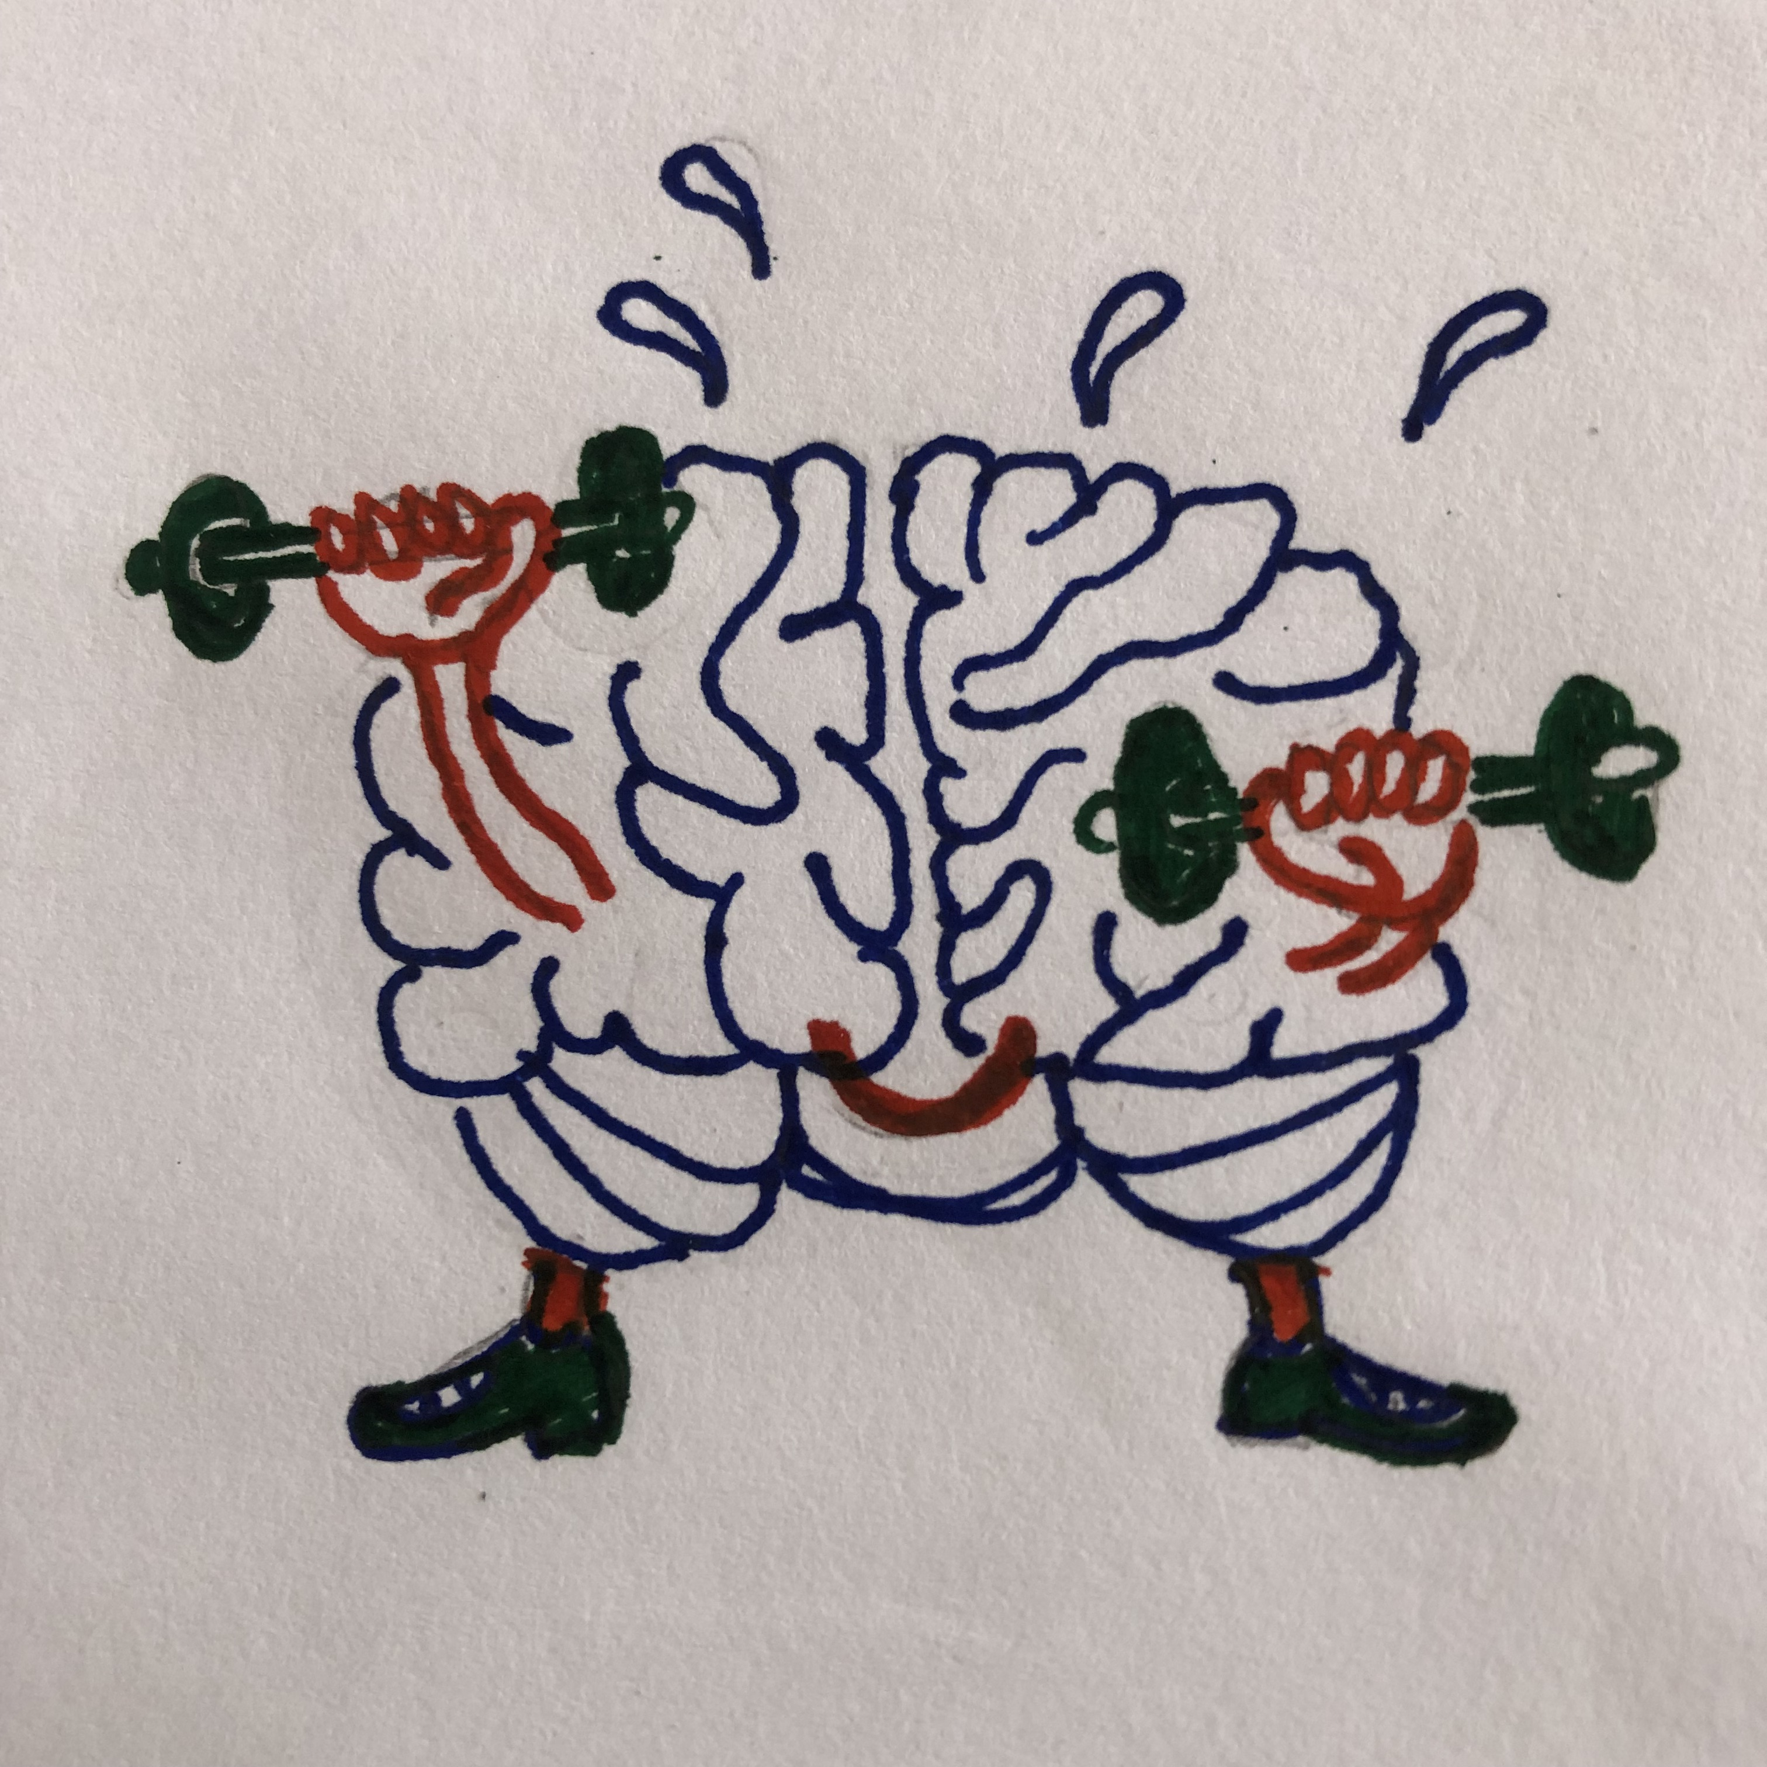
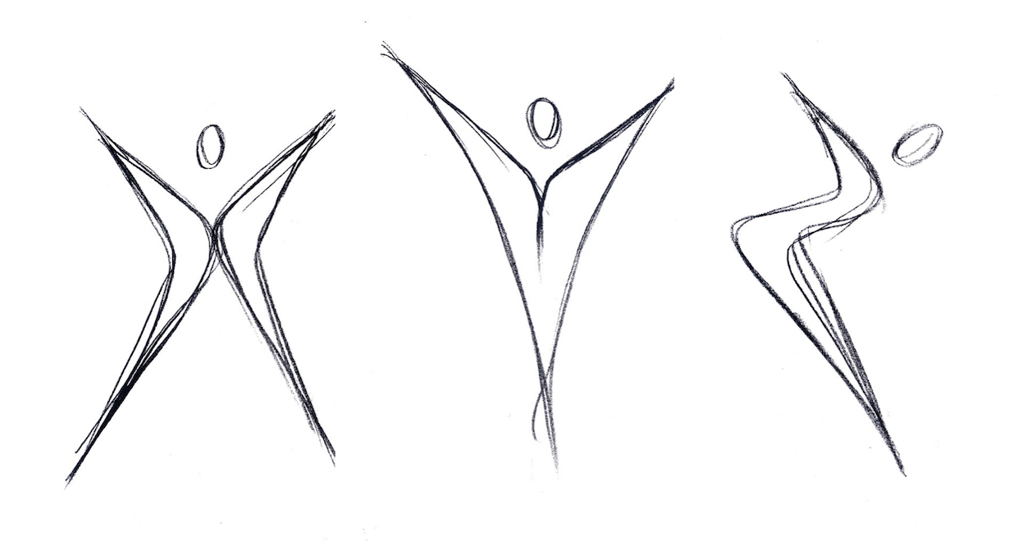
Strength training and brain health
© Bhanu Ramaswamy
Dr Bhanu Ramaswamy OBE, DProf, FCSP
7th September 2024
PEMRIG Annual Forum, Nottingham

Slide 2
Aims of the talk
Contextualise (research bias of) exercise and Parkinson’s
Provide a basic understanding of the muscular components of fitness: strength, power and endurance
Talk about resistance training including the benefits for brain health – message to everyone
Add in anything Parkinson’s-specific
Summary/ take home

Slide 3






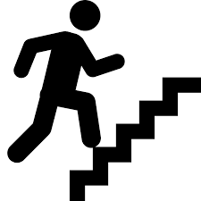










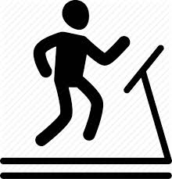


Adapted from home ‘Exercise’ message^{[1]}:
For people with Parkinson’s, taking part in exercise is as important as taking medication, eating and sleeping well.
Reproduced with kind permission of Dr Julie Jones (2018)

Slide 4
History of exercise and Parkinson’s^{[2]}
Decade | Trend or revolution
1960s | Levodopa introduced
1970s | Drugs improved; exercise considered unhelpful
1980s | Exercise considered adjunctive
1990s | Deep brain stimulation
2000s | Exercise complimentary with medication
2010+ | Exercise neuroplastic - possibly neuroprotective and neurorestorative
Reproduced with kind permission of Melissa McConaghy (2015)

Slide 5
Context of change into research bias
Research from 1980s – 2010 primarily led by, or for health professionals – measured by ‘easy’ function or symptoms.
Changes in:
Understanding of benefits of pushing exercise intensity in health conditions and
Population ages of people diagnosed with Parkinson’s
allowed research to consider, and then collaborate with Sport scientists and technologists improving knowledge around exercise dosage and styles.
Notes:
Frequency, intensity, time, type, volume, and progression
Styles from fitness components to mindful artistic styles - Tai Ch, Dance – Tango esp Argentinian, Zumba Gold®, Irish Set Dancing, Yoga, Pilates, Exergaming

Slide 6
Exercise Professionals Framework^{[3]}
Return movement quality
To reduce experience of symptoms by slowing disease progression (improve blood flow across the brain; increased levels of proteins associated with dopaminergic neurone survival e.g. brain- or glial-derived neurotropic factors; improve nerve connections)
Investing in exercise from diagnosis
Staying Active
Utilise/ build on exercise to prevent secondary complications of inactivity (non-Parkinson’s)
Falls risk reduction
Managing Complex Challenges
Maintenance of function
Tap into benefits of movement (postural preservation, respiratory function and pain management)

Slide 7
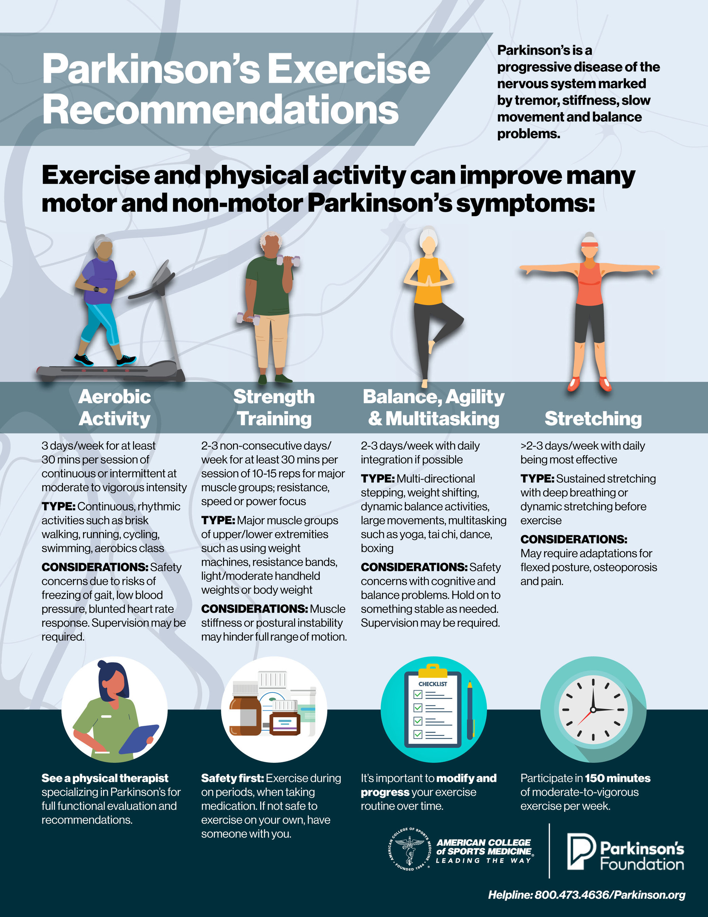
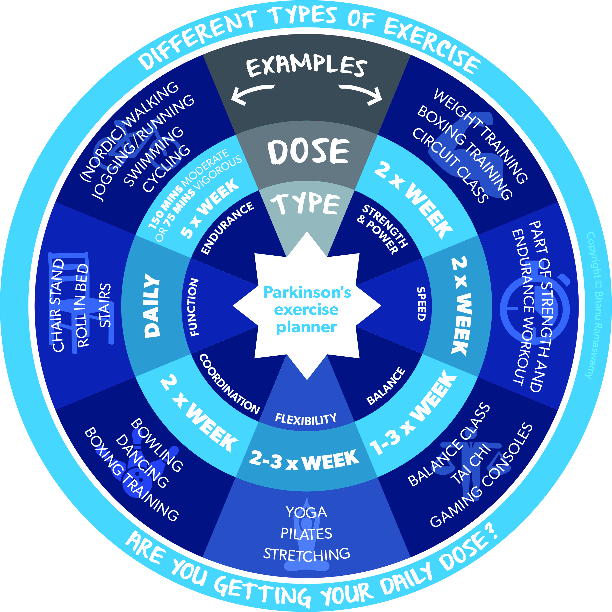
[4]
[2]

Slide 8
Definition of muscle output terms
Strength | Power | Endurance
The force muscle exerts in a single rep to overcome resistance. Example: Pushing an object or lifting a weight | The force muscle can produce quickly. Example: Standing quickly to answer a knock at the door. | Duration you can move a weight without getting exhausted. Example: Shopping in a supermarket then carrying the shopping to the car.

Slide 9
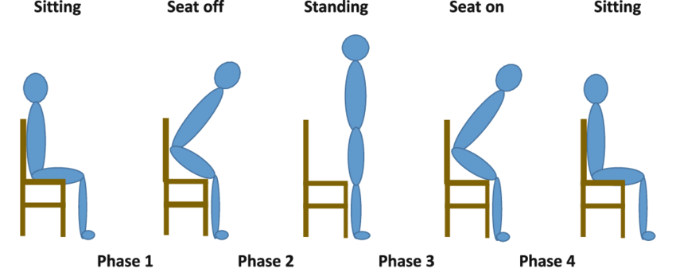
Let’s try it: 1. Strength

Slide 10
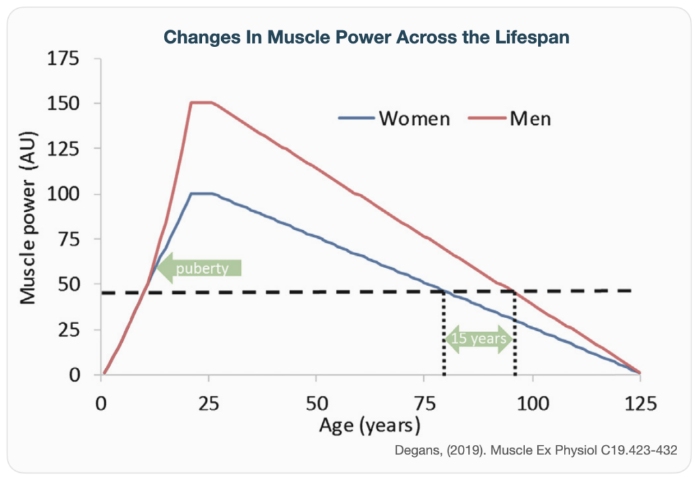
Muscle power and ageing^{[5]}

Slide 11
Let’s try it: 2. Power – 5 x in >16 secs

Slide 12
About resistance training: traditional
What is it?
The use of resistance to muscular contraction to build strength, anaerobic endurance and size of skeletal muscles.
Why is it important to train?
As we age, the decline of muscle power alters our performance of activity and function affecting our general health^{[5-7]}.
Training confers MANY benefits: improves overall health as well as muscle strength, tone, balance and flexibility; weight management; increases bone density; reduces risk of injury as performance of an activity and capacity to manage it improves.

Slide 13
About resistance training: more recent
Messaging of neurological benefits into brain health:
Moderate resistance training combined with aerobic work improved cognitive function and oxygenation to the pre-frontal cortex - better than higher intensity^{[8]}. [Young females; n = 36; dosage: 1 intervention]
People with cognitive decline improved cognition^{[9,10]}. [Ref 9= SR; Ref 10 = 12 months once vs twice weekly exs; n = 155 women; aged 65 - 75].
Unclear on precise mechanism or dosage but likely association with myokine impact on cellular function.
Notes:
Myokines are known to influence cells in the following three ways:
Autocrine, which affects the cells themselves
Paracrine, which affects nearby cells
Endocrine, which affects cells far away

Slide 14
Why for people with Parkinson’s?
Because many people with Parkinson’s:
Describe a feeling or experience of weakness when tasking.
  Impacts dependency for activities of daily living, falls risk, development of joint pain^{[11,12]}. Performance can improve^{[13]}.
Do less exercise than is required to remain fit in the face of a condition that negatively affects movement control.
  An example of a performance task is standing from a chair, walking distance reduction, stair climbing safety^{[6,11]}.
Don’t get the type of exercise or the dosage right!
Notes:
This reduction in dopamine results in a GABA-mediated tonic inhibition of the thalamus, which in turn reduces the excitation of the thalamus on cortical projection areas. This is manifested as an alteration in somatic motor activities and as a result, a person with PD can have difficulties contracting the muscles, thereby reducing the strength production
Improved muscle strength and tone: Resistance training can help protect joints from injury. It can also help build muscle and reduce muscle loss, which can help prevent sarcopenia in older people.
Improved balance and flexibility: Resistance training can help maintain balance and flexibility, which can help people remain independent as they age.
Weight management: Resistance training can help people manage or lose weight. As people gain muscle, their bodies burn more calories even when they're resting.
Increased bone density: Resistance training can increase bone density and reduce the risk of osteoporosis.
Improved posture: Resistance training can help improve posture.
Improved stamina: As people get stronger, they won't get tired as easily.
Reduced risk of injury: Resistance training can help reduce the risk of injuries caused by repetitive movements.
Improved coordination: Resistance training can help improve coordination.
Improved performance and exercise capacity: Resistance training can lead to adaptations in the musculoskeletal and cardiovascular systems, which can improve performance and exercise capacity.
This reduction in dopamine results in a GABA-mediated tonic inhibition of the thalamus, which in turn reduces the excitation of the thalamus on cortical projection areas. This is manifested as an alteration in somatic motor activities and as a result, a person with PD can have difficulties contracting the muscles, thereby reducing the strength production

Slide 15
What is Parkinson’s research showing?
3-month, 2 x week training significantly reduced bradykinesia and increased muscle strength and power in older pwP^{[13,14]}.
Resistance training reduces depressive symptoms and improves the quality of life and functionality of elderly with Parkinson’s^{[18]}. N = 33 in 2 groups; dose 1 x week RT vs control x 20 weeks.
RT improves sleep quality^{[19]}. N=22 in 2 groups of PRT + no exercise + additional control; 2 x week x 12 weeks.
MA: Expected improvements in motor symptoms, slight improvement in QoL^{[15]}.
RT improves anxiety & QoL^{[20]}. N=35 in 2 groups. Both = usual intervention + PRT in intervention group; 2 x week x 24 weeks.
Possibility of increasing BDNF from training (MA mixed review in healthy populations of AT>RT^{[16]} or RT>other^{[17]}). No difference in training type for pwP^{[14]}.
General possibilities: peripheral (condition of musculo-skeletal system) and central (brain)^{[21]}. Centrally, PRT may improve cortical activity improving symptoms and slowing progression; may promote angiogenesis and synaptogenesis.
MA = Meta analysis; SR = systematic review; (P)RT = (Progressive resistance training; QoL = Quality of life
Notes:
Brain-Derived Neurotrophic Factor (BDNF) protects the brain against destruction of dopaminergic neurons and acts as a growth factor for dopaminergic neurons of the substantia nigra pars compacta. And inverse relationship with severity of symptoms and levels of BDNF.
When directly compared to brain-derived neurotrophic factor (BDNF), GDNF corrected behavioral deficits and protected nigrostriatal dopaminergic neurons better than BDNF
Sleep quality = Sleep quality and daytime dysfunction.

Slide 16
Let’s try it: 3. Endurance – 30 secs

Slide 17
What dosage are we talking about?^{[4]}
Frequency: 2-3 days/ week – major muscle groups on odd days.
Intensity: 40-50% of 1-RM for beginners. 60-70% 1- RM for more advanced exercisers. Progress repetitions and resistance, working muscles to fatigue.
Timing: 10-15 repetitions starting an exercise program. ≥1 set of 8-12 repetitions (~60% 1-RM) and progress to 3 sets of 8 -10 to fatigue. Build to 2-3 hours/week.
Type: Major muscle groups of the upper and lower body using weight machines, resistance bands, or body weight. Focus on extensors. Could use resistance training with instability.

Slide 18
How do I/ We get started?
Find the right trainer who will understand changes in posture and body mechanics of Parkinson’s and its progression.
Be coached to perform 1- RM safely.
Find an exercise pal to overcome future apathy and argument!
Initially safer to avoid heavy free weights unless supervised or assisted because of the nature of body asymmetry.
Time training with ON periods of optimal gain. Consider other medical conditions that might be helped or hindered by this type of training.

Slide 19
Conclusion
This is exciting stuff!
Possibilities of progressive resistance training linked to improved cognition and motor function in pwP.
Exercise intensity is important, yet we are not clear about the scaling for people with neurological conditions.
Still recommending Progressive Resistance Training as part of a set of exercise styles.
If you don’t try it, you’ll never know!!

Slide 20
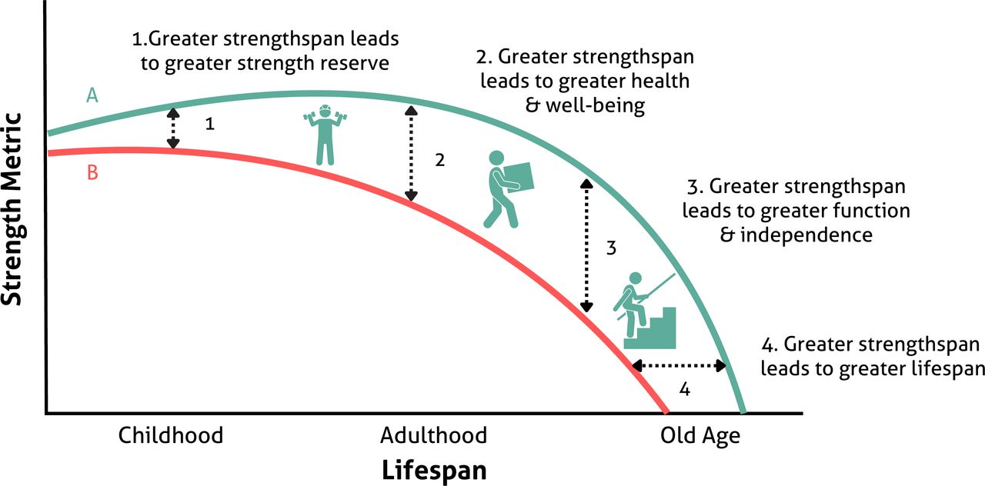
Its all about the Strengthspan!^{[22]}
Start strong Be strong Stay strong

Slide 21
Let’s try it again. Power – 5 x in >16 secs

Slide 22
Acknowledgements:
PEMRIG team for putting on such a good day’s learning.
People with Parkinson’s and colleagues who ask questions.
People who research the subject who provide some answers.
Any questions?

Slide 23
References
Ernst M, Folkerts A-K, Gollan R, et al (2023). Physical exercise for people with Parkinson’s disease: a systematic review and network meta‐analysis. Cochrane Database of Systematic Reviews 2023, Issue 1. Art. No.: CD013856. DOI: 10.1002/14651858.CD013856.pub2. Accessed 24 August 2024
McConaghy M (2014). The new Parkinson's’ treatment: Exercise is medicine. Publish-Me, New South Wales
Parkinson’s UK (2017). The Exercise Framework support for people with Parkinson’s. Accessed at: www.parkinsons.org.uk/information-and-support/parkinsons-exercise-framework 16.08.2024.
Parkinson’s Foundation and the American College of Sports Medicine (2021). Parkinson’s Exercise recommendations. Accessed at: https://www.parkinson.org/resources-support/professionals/resources/exercise-professionals 16.08.2024.
Degens H (2019). Muscle and Exercise Physiology Ed: Jerzy A. Zoladz, AcaChapter 19 - Human Ageing: Impact on Muscle Force and Power. Academic Press, Pages 423-432,
Rantanen T, Avlund K, Suominen H, et al (2002). Muscle strength as a predictor of onset of ADL dependence in people aged 75 years. Aging Clin Exp Res; 14 (3 Suppl):10-5.
Momma H, Kawakami R, Honda T, et al (2022). Muscle-strengthening activities are associated with lower risk and mortality in major non-communicable diseases: a systematic review and meta-analysis of cohort studies. British Journal of Sports Medicine, 56: 755-763.
Chang H, Kim K, Jung Y-J, Kato M (2017). Effects of acute high-Intensity resistance exercise on cognitive function and oxygenation in prefrontal cortex. Phys Act Nutr. 21 (2): 1 - 8.
Herold F, Törpel A, Schega L. et al. (2019). Functional and/or structural brain changes in response to resistance exercises and resistance training lead to cognitive improvements – a systematic review. Eur Rev Aging Phys Act 16, 10 (2019). https://doi.org/10.1186/s11556-019-0217-2.
Liu-Ambrose T, Nagamatsu LS, Graf P, et al (2010). Resistance Training and Executive Functions: A 12-Month Randomized Controlled Trial. Arch Intern Med. 2010;170(2):170–178. doi:10.1001/archinternmed.2009.494
Paul SS, Canning CG, Sherrington C, et al (2012). Reduced muscle strength is the major determinant of reduced leg muscle power in Parkinson's disease. Parkinsonism Relat Disord. 2012 Sep;18(8):974-7.
Clael S, Brandao E, Caland L et al (2018). Association of strength and physical functions in people with Parkinson's disease. Neurosci. J; DOI: 10.1155/2018/8507018.
Ni M, Signorile JF, Balachandran A et al (2016). Power training induced change in bradykinesia and muscle power in Parkinson’s Disease. Parkinson’s Disease and related disorders; 23: 37 – 44.
Paterno A, Polsinelli G, Federico B (2024). Changes of brain-derived neurotrophic factor (BDNF) levels after different exercise protocols: a systematic review of clinical studies in Parkinson’s disease. Frontiers in Physiology; 15. DOI: 10.3389/fphys.2024.1352305.
Gollan R, Ernst M, Lieker, E et al (2022). Effects of resistance training on motor-and non-motor symptoms in patients with Parkinson’s disease: a systematic review and meta-analysis. Journal of Parkinson's disease, 12(6): 1783 - 1806.
Dinoff A, Herrmann N, Swardfager W, et al (2016). The Effect of Exercise Training on Resting Concentrations of Peripheral Brain-Derived Neurotrophic Factor (BDNF): A Meta-Analysis. DOI: 10.1371/journal.pone.0163037.
Zhou B, Wang Z, Zhu L, et al (2022). Effects of different physical activities on brain-derived neurotrophic factor: A systematic review and bayesian network meta-analysis. Front Aging Neurosci. DOI: 10.3389/fnagi.2022.981002.
Alcenar de Lima T, Ferreira-Moraes R, da Costa Alves WMG et al (2019). Resistance training reduces depressive symptoms in elderly people with Parkinson disease: A controlled randomized study. Scandinavian J of Med and Sci in Sports. 29 (12): 1957 - 1967
Silva-Batista C; de Brito LC, Corcos DM et al (2017). Resistance Training Improves Sleep Quality in Subjects With Moderate Parkinson's Disease. Journal of Strength and Conditioning Research; 31(8): 2270 – 2277.
Ferreira RM, Alves WMG da C, Lima TA de et al (2018). The effect of resistance training on the anxiety symptoms and quality of life in elderly people with Parkinson's disease: a randomized controlled trial. Arq Neuro-Psiquiatr [Internet]: 76(8): 499 – 506.
David FJ, Rafferty MR, Robichaud JA et al (2011). Progressive Resistance Exercise and Parkinson′s Disease: A Review of Potential Mechanisms. Parkinson’s Disease: https://doi.org/10.1155/2012/124527.
Faigenbaum AD, Garcia-Hermoso A, MacDonald JP, et al (2024). Bridging the gap between strengthspan and lifespan. British Journal of Sports Medicine; 58: 758 - 760.

